Slide 1
Chapter 4
Economic Efficiency and Government Price Setting
Notes:
Welcome to Economics!
Does this work?

Slide 2
Would you prefer an economic system where goods were rationed by:
Need
Equality/fairness
Who can pay the most
In an unregulated competitive market, the price adjusts until:
Sometimes the govt gets involved and tries to control prices.
Price ceiling A legally determined maximum price that sellers may charge.
Price floor A legally determined minimum price that sellers may receive.

Slide 3
Evaluating these policies and others require that we consider their impact on the well-being (“welfare”) of consumers and producers.
Consumer Welfare
If a consumer pays $20 for a new scarf, would do we know about the marginal benefit that she expects to get from that scarf?
Consumer surplus The difference between the highest price a consumer is willing to pay for a good or service and the price the consumer actually pays.
Marginal benefit The additional benefit to a consumer from consuming one more unit of a good or service.

Slide 4
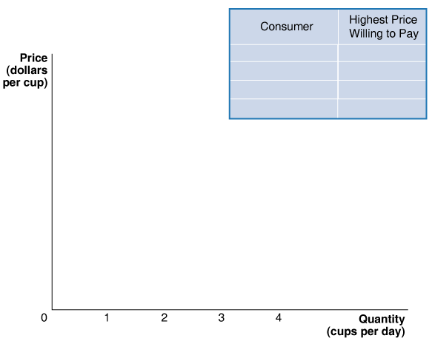
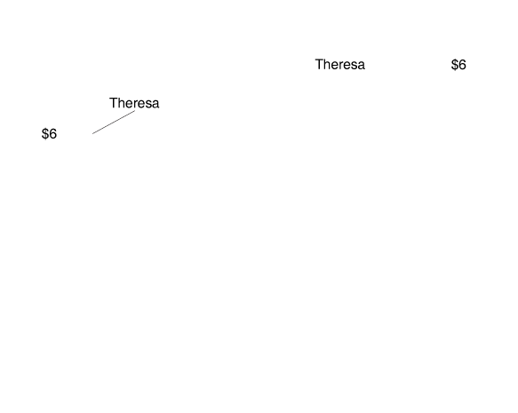
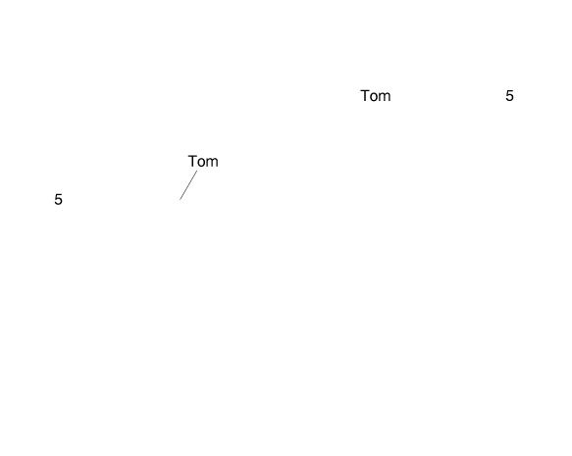
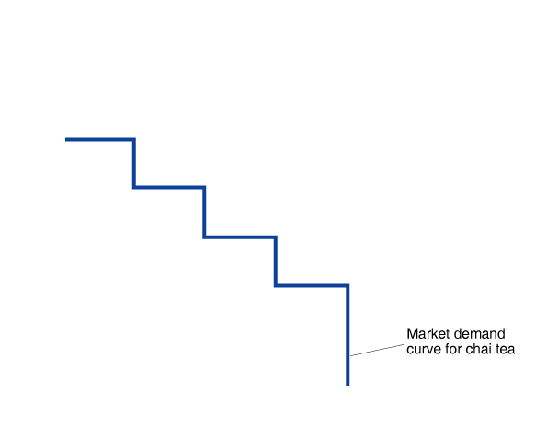
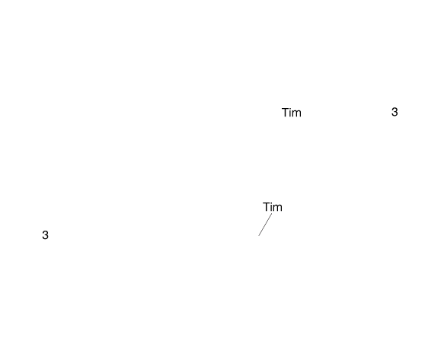
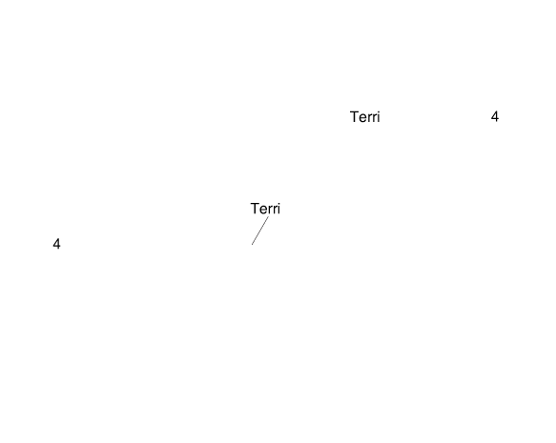
Consumer Surplus and Producer Surplus
4.1 LEARNING OBJECTIVE
Distinguish between the concepts of consumer surplus and producer surplus.
Deriving the Demand Curve for Chai Tea
FIGURE 4-1

Slide 5
Consumer Surplus and Producer Surplus
4.1 LEARNING OBJECTIVE
Distinguish between the concepts of consumer surplus and producer surplus.
Consumer Surplus if Price = $3
Deriving the Demand Curve for Chai Tea
FIGURE 4-1

Slide 6
Consumer Surplus and Producer Surplus
4.1 LEARNING OBJECTIVE
Distinguish between the concepts of consumer surplus and producer surplus.
Consumer Surplus if Price = $3.50
Deriving the Demand Curve for Chai Tea
FIGURE 4-1

Slide 7
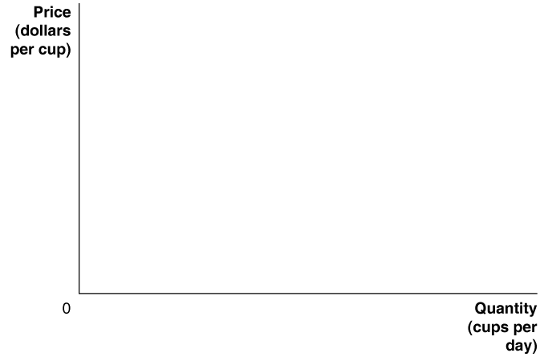

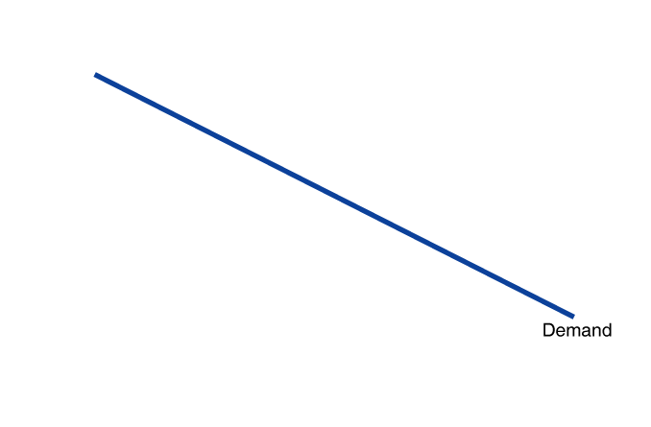
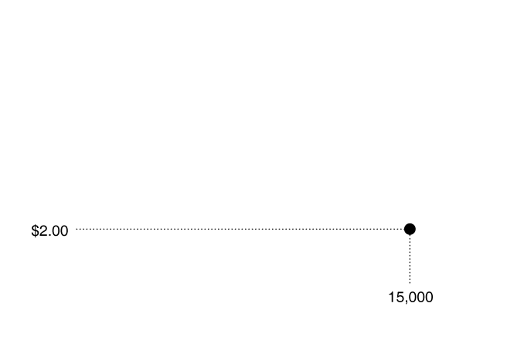
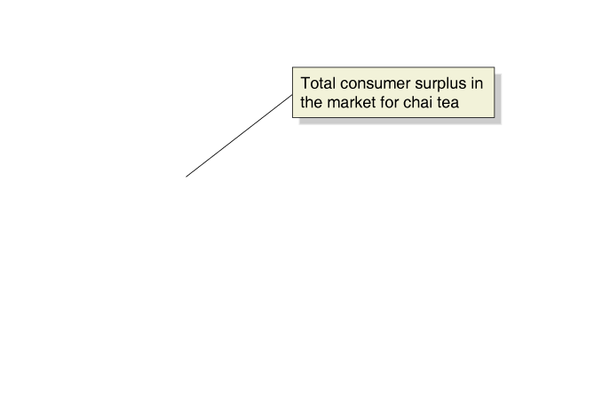
Consumer Surplus and Producer Surplus
4.1 LEARNING OBJECTIVE
Distinguish between the concepts of consumer surplus and producer surplus.
Total Consumer Surplus in the Market for Chai Tea
Consumer Surplus
FIGURE 4-3
The demand curve tells us that most buyers of chai tea would have been willing to pay more than the market price of $2.00.
For each buyer, consumer surplus is equal to the difference between the highest price he or she is willing to pay and the market price actually paid.
Therefore, the total amount of consumer surplus in the market for chai tea is equal to the area below the demand curve and above the market price. Consumer surplus represents the benefit to consumers in excess of the price they paid to purchase the product.

Slide 8


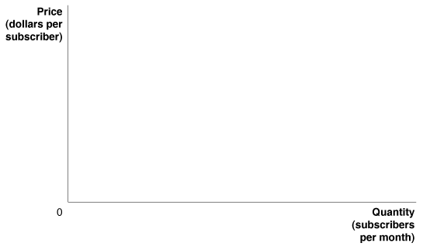
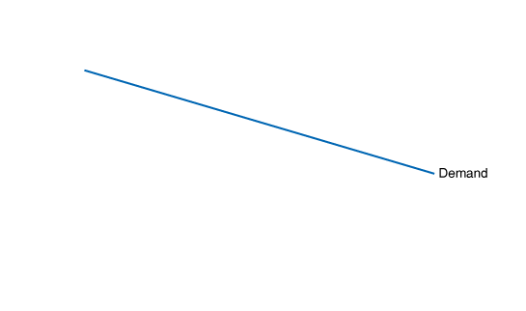
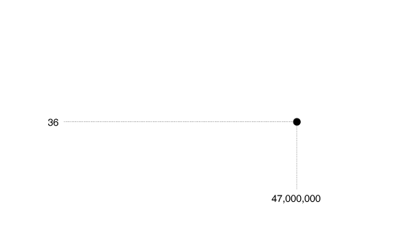
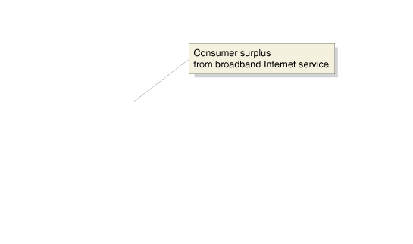
4.1 LEARNING OBJECTIVE
Distinguish between the concepts of consumer surplus and producer surplus.
This figure shows the consumer surplus that households receive from subscribing to broadband internet service, which is estimated to be $890.5 million per month.

Slide 9
Producer Welfare
If a producer is willing to supply a scarf at the market price of $20, what do we know about the smallest amount of money that she is willing to accept for that scarf?
Producer surplus The difference between the lowest price a firm would be willing to accept for a good or service and the price it actually receives.
Marginal cost The additional cost to a firm of producing one more unit of a good or service.

Slide 10



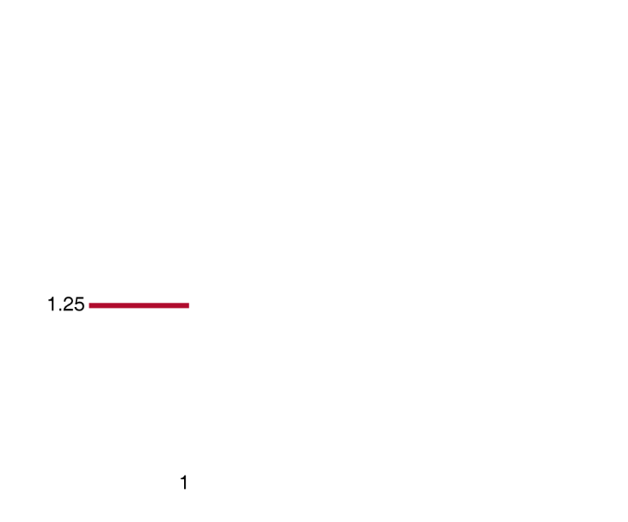
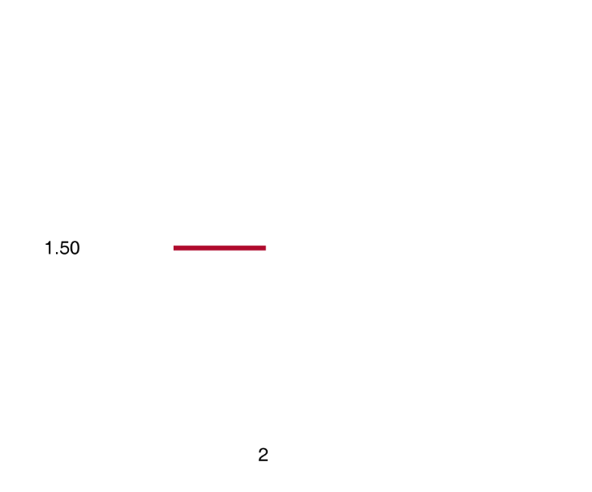
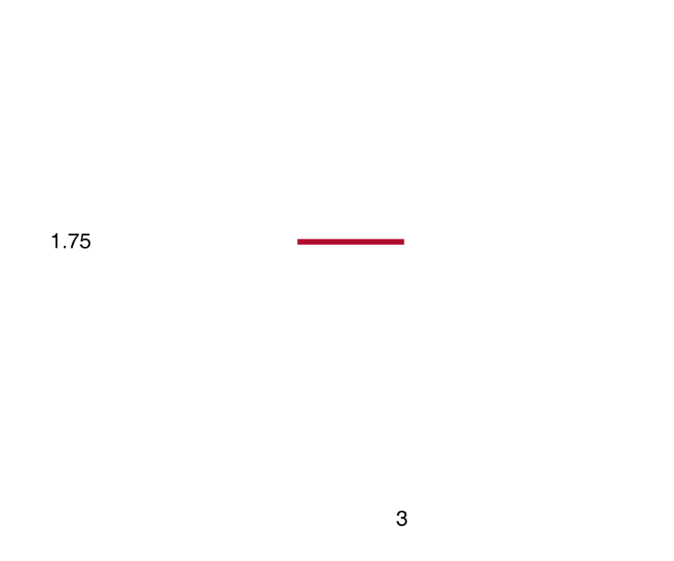
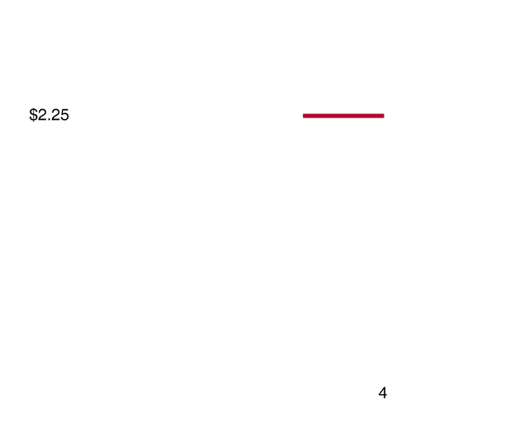

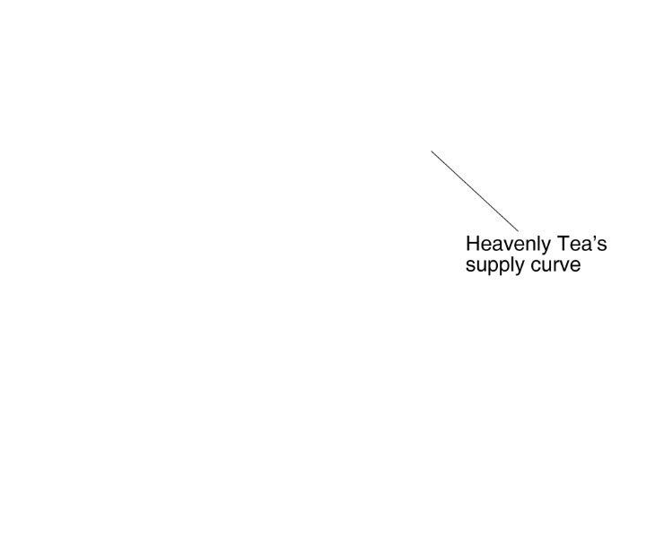
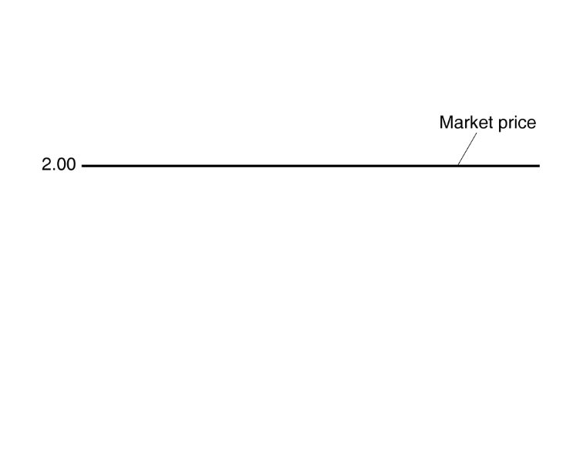

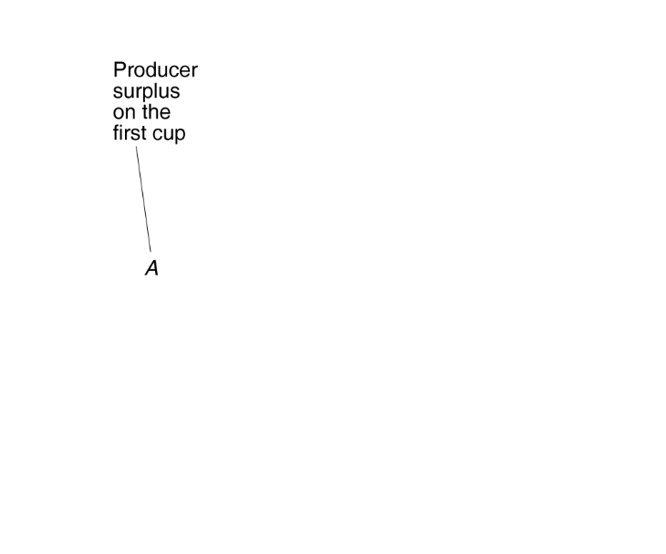
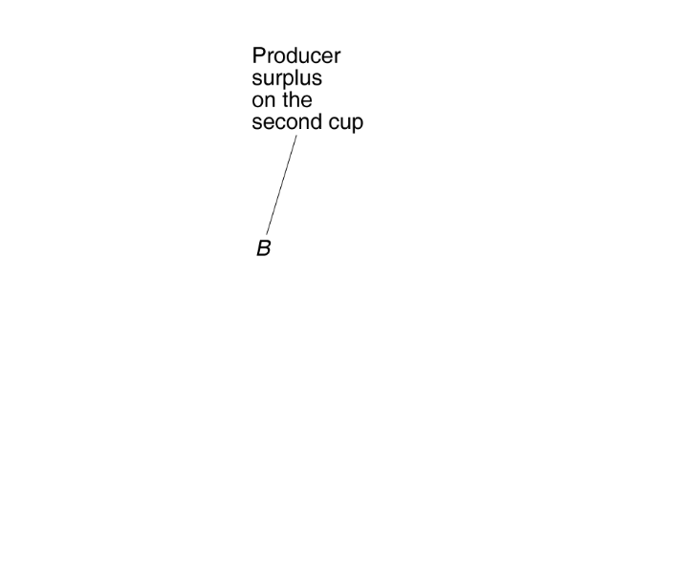
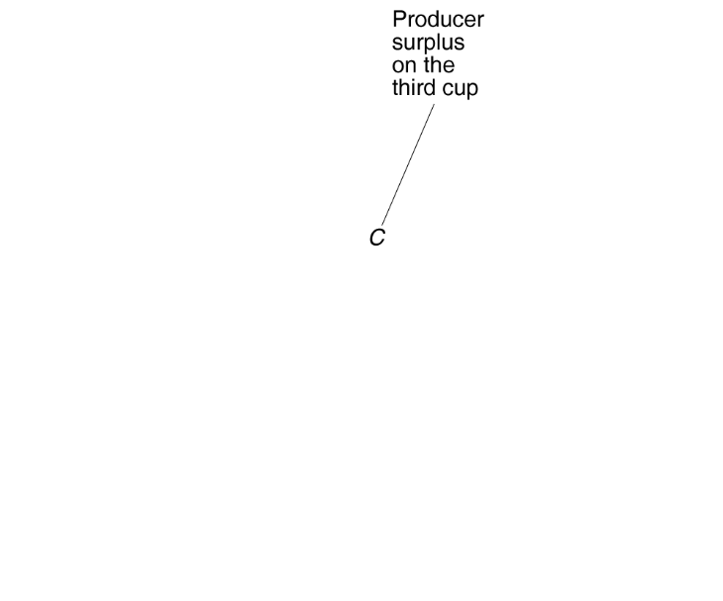
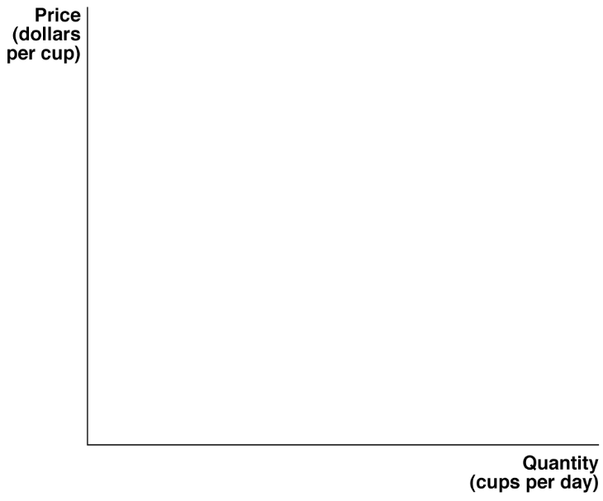
 | Price Seller Receives | Marginal cost | Producer Surplus
1st Cup
2nd Cup
3rd Cup
Producer Surplus from selling tea:

Slide 11
Consumer Surplus and Producer Surplus
4.1 LEARNING OBJECTIVE
Distinguish between the concepts of consumer surplus and producer surplus.
Total Producer Surplus in the Market for Chai Tea
Consumer Surplus
FIGURE 4-3
Supply
The demand curve tells us that most buyers of chai tea would have been willing to pay more than the market price of $2.00.
For each buyer, consumer surplus is equal to the difference between the highest price he or she is willing to pay and the market price actually paid.
Therefore, the total amount of consumer surplus in the market for chai tea is equal to the area below the demand curve and above the market price. Consumer surplus represents the benefit to consumers in excess of the price they paid to purchase the product.

Slide 12
Now we focus on the net benefit to society as a whole. Who is part of society?
Consumers
Producers
Total Economic Surplus is the surplus to accrues to all members of society. In simple competitive markets it is equal to:
Key Question: Does a competitive market maximize total economic surplus?

Slide 13
Consumer Surplus and Producer Surplus
4.1 LEARNING OBJECTIVE
Distinguish between the concepts of consumer surplus and producer surplus.
Total Economic Surplus in the Market for Chai Tea
Consumer Surplus
FIGURE 4-3
The demand curve tells us that most buyers of chai tea would have been willing to pay more than the market price of $2.00.
For each buyer, consumer surplus is equal to the difference between the highest price he or she is willing to pay and the market price actually paid.
Therefore, the total amount of consumer surplus in the market for chai tea is equal to the area below the demand curve and above the market price. Consumer surplus represents the benefit to consumers in excess of the price they paid to purchase the product.
$10
Supply
$2
$0.25
Demand
15,000

Slide 14
Thinking about the efficiency of a market from a marginal perspective
Price
S
P
D
Q
Quantity

Slide 15
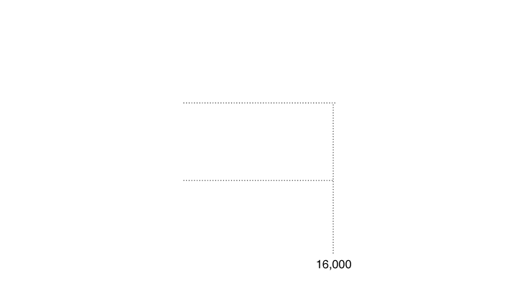
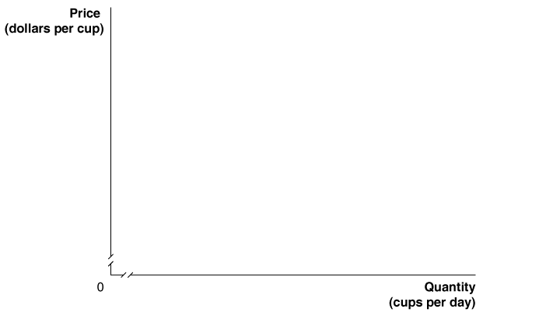
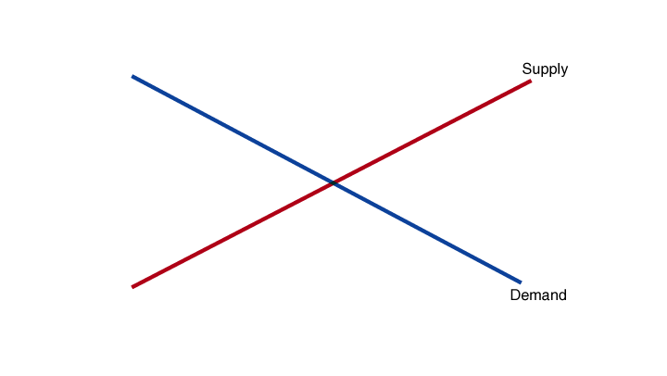
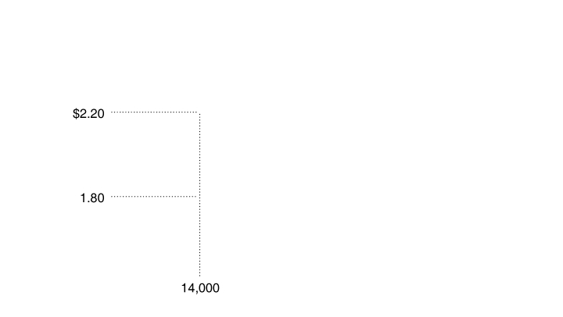
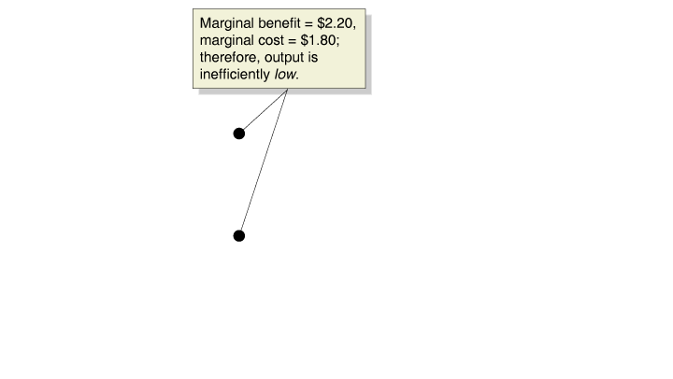
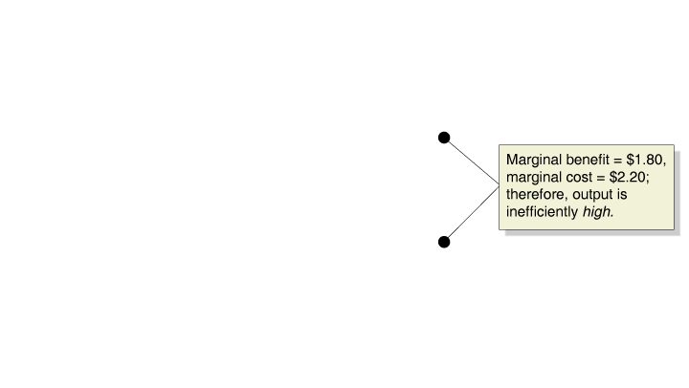
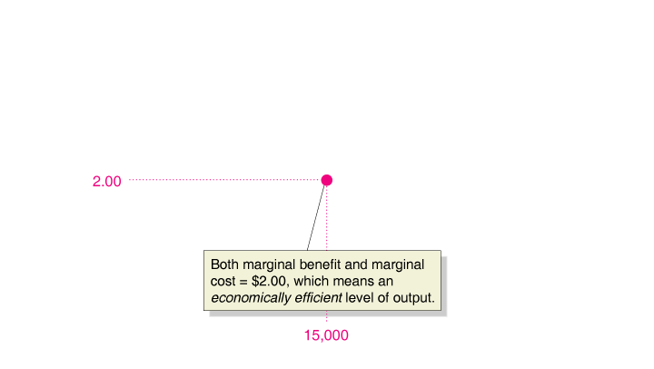
The Efficiency of Competitive Markets
4.2 LEARNING OBJECTIVE
Understand the concept of economic efficiency.
Marginal Benefit Equals Marginal Cost in Competitive Equilibrium
FIGURE 4-5
Marginal Benefit Equals Marginal Cost Only at Competitive Equilibrium
In a competitive market, equilibrium occurs at a quantity of 15,000 cups and a price of $2.00 per cup, where marginal benefit equals marginal cost. This is the economically efficient level of output because every cup has been produced where the marginal benefit to buyers is greater than or equal to the marginal cost to producers.

Slide 16
A Free Market Maximizes Producer plus Consumer Surplus (the gains from trade)
Price of Chai Tea
Supply Curve
Buyers
Non-Sellers
Consumer Surplus
Equilibrium Price
$2
Producer Surplus
Sellers
Non-Buyers
Demand Curve
15,000
Quantity of Chai Tea
Equilibrium Quantity
Notes:
Instructor Notes: Figure 3.4: A Free Market Maximizes Producer Plus Consumer Surplus (the Gains from Trade) A free market maximizes the gains from trade because (1) buyers are willing to pay more for the good than non-buyers, (2) sellers are willing to sell the good at a lower price than non-sellers, and (3) there are no mutual profitable deals between non-sellers and non-buyers.

Slide 17
Equilibrium and Total Surplus
Equilibrium in a free market yields two important results:
Goods must be produced at the lowest possible cost.
Goods must satisfy the highest valued demands.
These results indicate that total surplus (both of the consumer and producer) is maximized in free markets.

Slide 18
Recap of the power of markets
In competitive markets, prices adjust to ensure that:
After the price adjusts and the market equilibrium is achieved, the price is simultaneously equal to the marginal benefit and the marginal cost of the last unit (“the marginal unit”) of output traded. As such, what kind of information does the price contain?

Slide 19

“I am still recovering from the shock of the experimental results. The outcome was unbelievably consistent with competitive price theory. ”
Vernon Smith, winner of 2002 Nobel Prize in Economics, on his 1956 experiments designed to disprove the supply and demand model.
Vernon Smith proved the invisible hand was there.

Slide 20
Getting in the way of the invisible hand?
Distorted price signals cause resources to be misallocated.

Slide 21

What happens if we raise the actual price of wheat above the equilibrium price?

Slide 22
Price Floor Example: U.S. Agricultural Policy
Price
S
D
Quantity

Slide 23
Welfare Effects of a Price Floor
 | Without Price Floor | With Price Floor | Net Changes in Welfare | Better Off?
Producer Surplus
Consumer Surplus
Economic Surplus

Slide 24
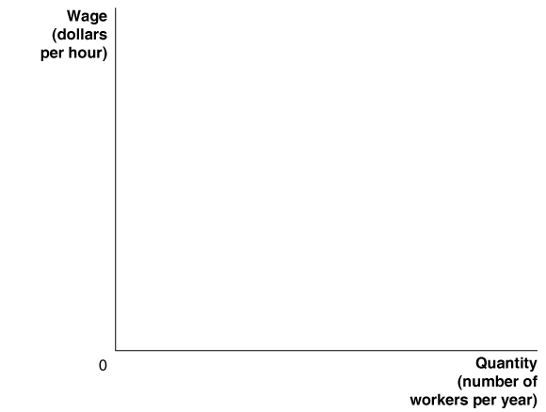
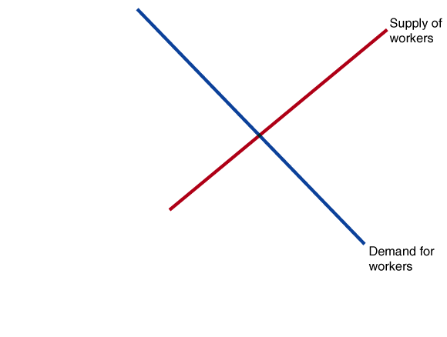
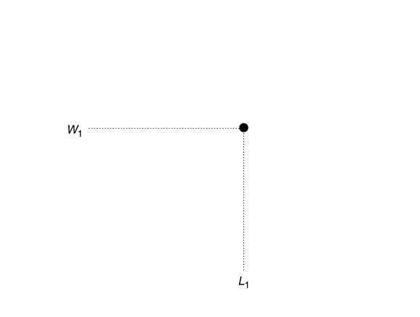
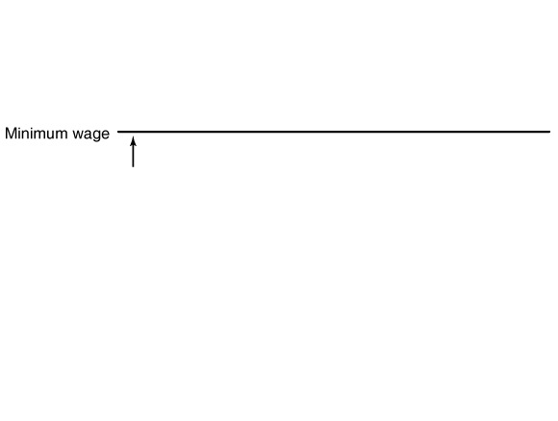
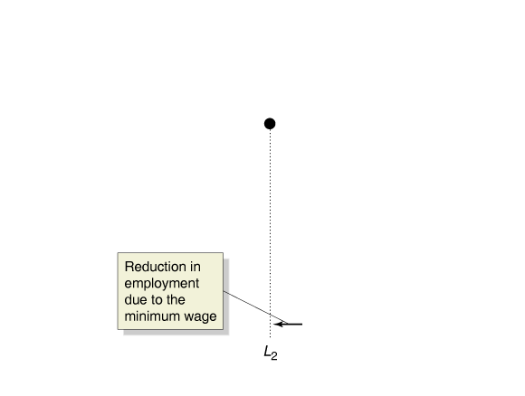
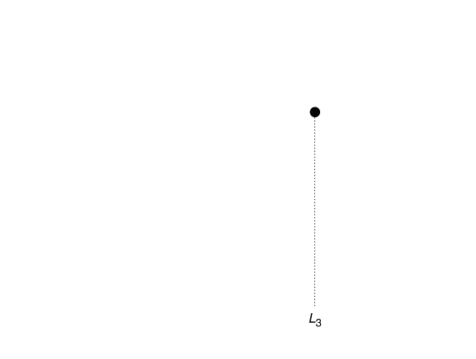
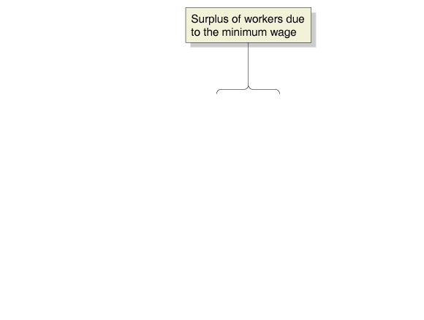
4.3 LEARNING OBJECTIVE
Making the Connection
Explain the economic effect of government-imposed price floors and price ceilings.
Price Floors in Labor Markets: The Debate over Minimum Wage Policy
YOUR TURN: Test your understanding by doing related problem 3.12 at the end of this chapter.

Slide 25
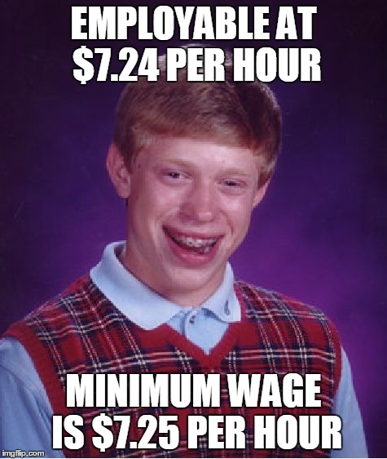
The Disemployment Effect of the Minimum Wage

Slide 26

Below equilibrium prices cause shortages. Do these “low prices” benefit consumers?

Slide 27
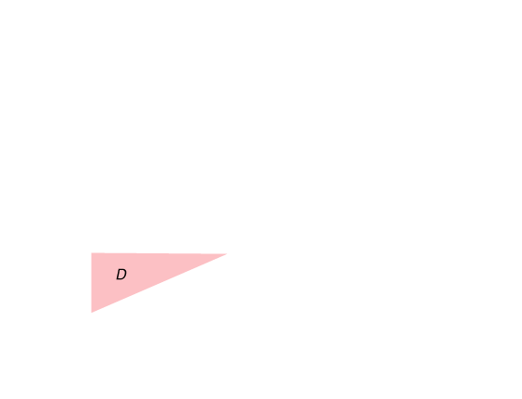
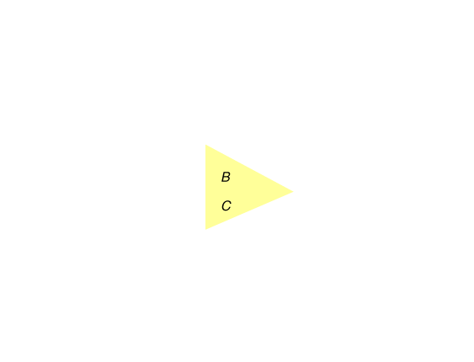
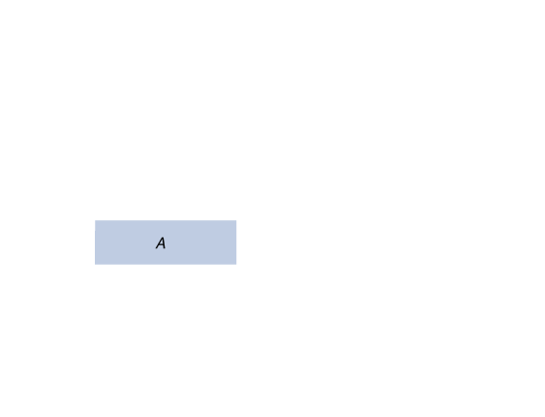
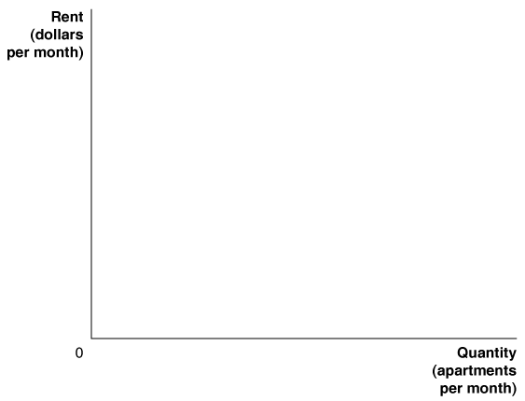
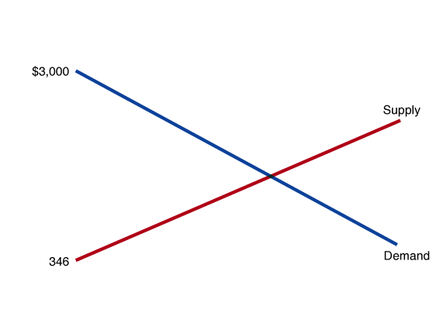
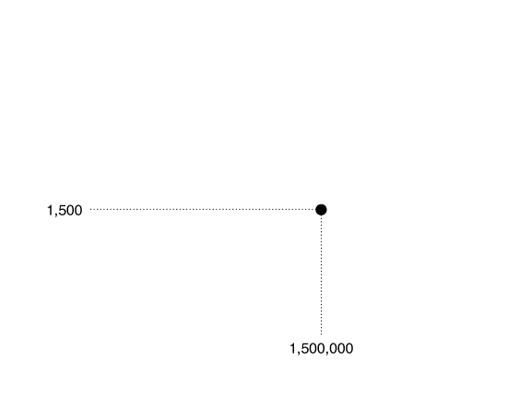
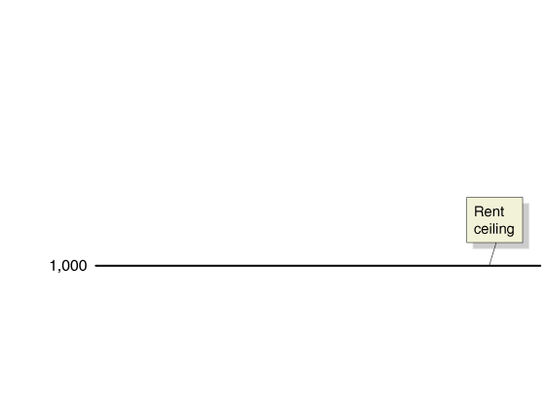
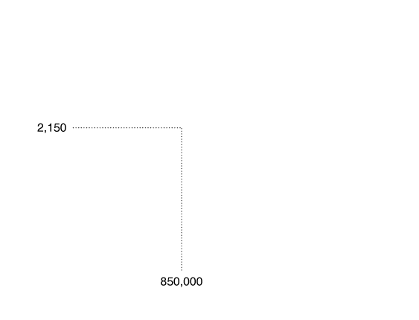
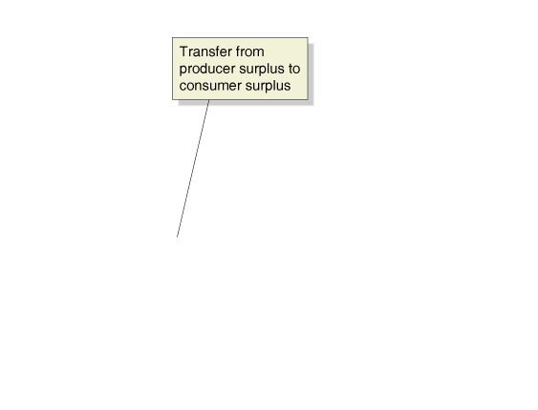
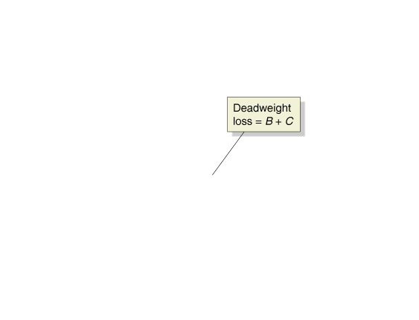
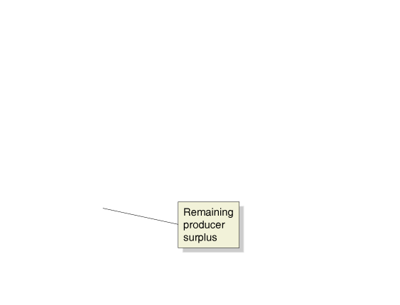
Appendix
LEARNING OBJECTIVE
Use quantitative demand and supply analysis.
Quantitative Demand and Supply Analysis
Price Ceiling Example: Rent Control Policies
Calculating Consumer Surplus and Producer Surplus
FIGURE 4A-2
Once we have estimated equations for the demand and supply of rental housing, a diagram can guide our numeric estimates of the economic effects of rent control.
Consumer surplus falls by an amount equal to the area of the yellow triangle B and increases by an amount equal to the area of the blue rectangle A. The difference between the values of these two areas is $213,750,000.
Producer surplus falls by an amount equal to the area of the blue rectangle A plus the area of the yellow triangle C. The value of these two areas is $587,500,000.
The remaining producer surplus is equal to the area of triangle D, or $278,000,000.
Deadweight loss is equal to the area of triangle B plus the area of triangle C, or $373,750,000.

Slide 28
Welfare Effects of a Price Ceiling
 | Without Price Ceiling | With Price Ceiling | Net Changes in Welfare | Better Off?
Producer Surplus
Consumer Surplus
Economic Surplus

Slide 29
Appendix
LEARNING OBJECTIVE
Use quantitative demand and supply analysis.
Quantitative Demand and Supply Analysis
Calculating the Economic Effect of Rent Controls
Calculating Consumer Surplus and Producer Surplus
FIGURE 4A-2
Once we have estimated equations for the demand and supply of rental housing, a diagram can guide our numeric estimates of the economic effects of rent control.
Consumer surplus falls by an amount equal to the area of the yellow triangle B and increases by an amount equal to the area of the blue rectangle A. The difference between the values of these two areas is $213,750,000.
Producer surplus falls by an amount equal to the area of the blue rectangle A plus the area of the yellow triangle C. The value of these two areas is $587,500,000.
The remaining producer surplus is equal to the area of triangle D, or $278,000,000.
Deadweight loss is equal to the area of triangle B plus the area of triangle C, or $373,750,000.

